Slide 1




AURA MIND
AI-based personal Assistant

Slide 2
TEAM
Abhi Patel- 40289176
Shrawan Malyala- 40236492
Sree Pravallika Pulikallu- 40265832
Vandit Mehta- 40232414
GITHUB LINK
https://github.com/ShrawanSai/SOEN6841_AuraMind

Slide 3
TABLE OF CONTENTS
02
03
04
05
06
01
Introduction
Market Justification
Feasibility & Viability
Solution Highlights
Project Plan
Risk Management
07
Budget
08
Conclusion

Slide 4
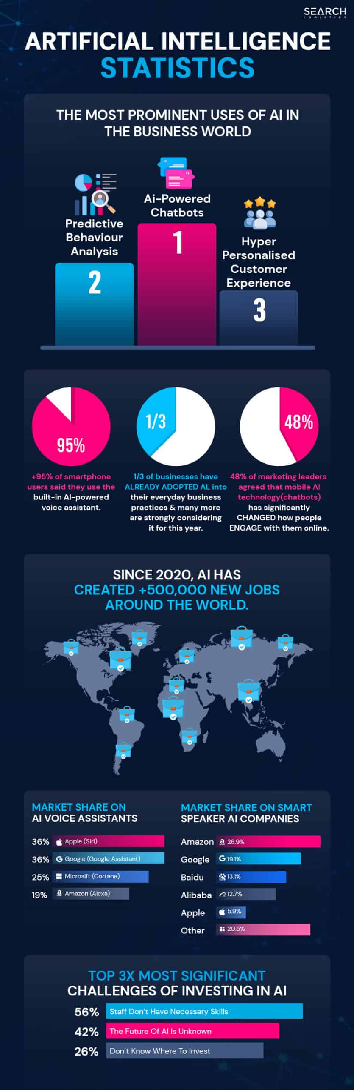


01
Introduction

Slide 5

Introducing your new AI-based personal assistant – your ultimate partner in crime for conquering the chaos of daily life! Imagine having a digital dynamo at your beck and call, ready to tackle tasks with a touch of humor and a dash of energy. From organizing your schedule to cracking a joke when you need a pick-me-up, this assistant is not just smart; it's downright fun! Get ready to meet your new bestie in the world of productivity – because with our Aura Mind, the future is bright, lively, and totally on point! Let's dive in and discover the magic together!

Slide 6
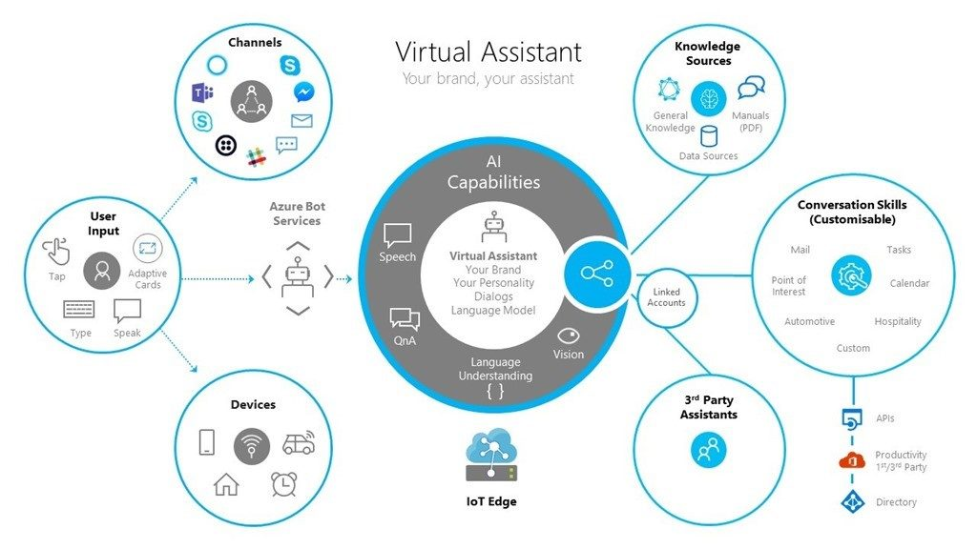


Slide 7
02
MARKET ANALYSIS

Slide 8
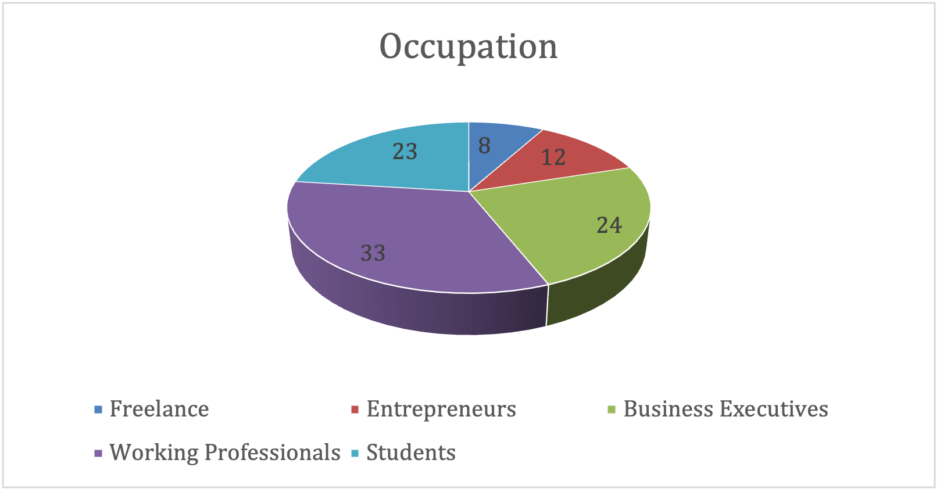
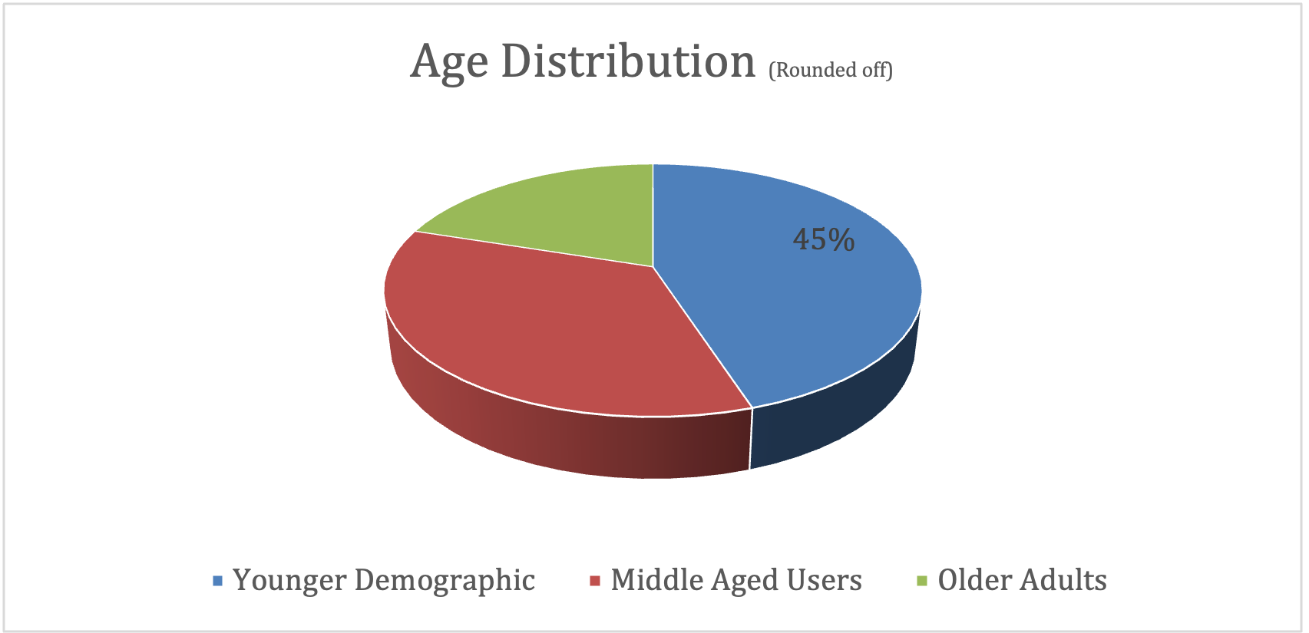
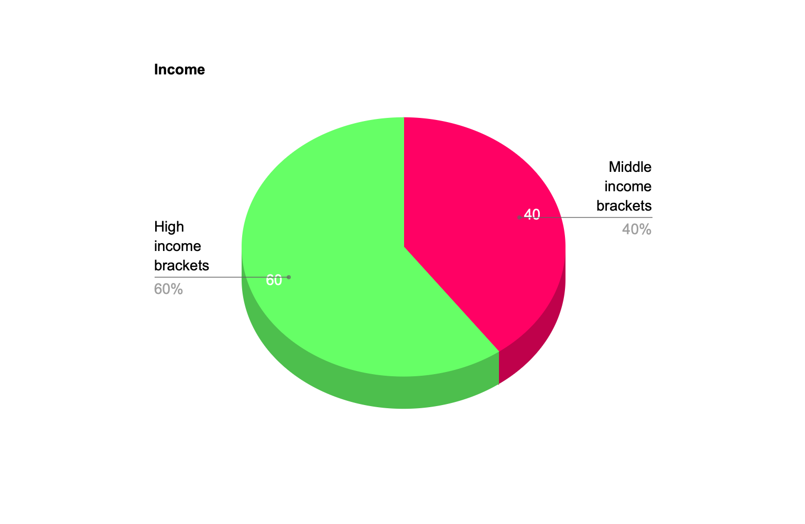
Primary Target Audience
Highly diverse spanning multiple age groups, occupations, and income levels.
Usage patterns vary across age groups:
Younger demographics: Active smartphone users.
Middle-aged users: Employ for productivity.
Older adults: Prefer Amazon Alexa and Apple Siri.
Professionals from various industries, accessible across income levels.
Notes:
References :
https://www.techtarget.com/searchcustomerexperience/definition/virtual- assistant-AI-assistant
https://reply.io/virtual-ai-assistant/
https://scoop.market.us/virtual-assistant-statistics/
https://builtin.com/artificial-intelligence/ai-assistant

Slide 9
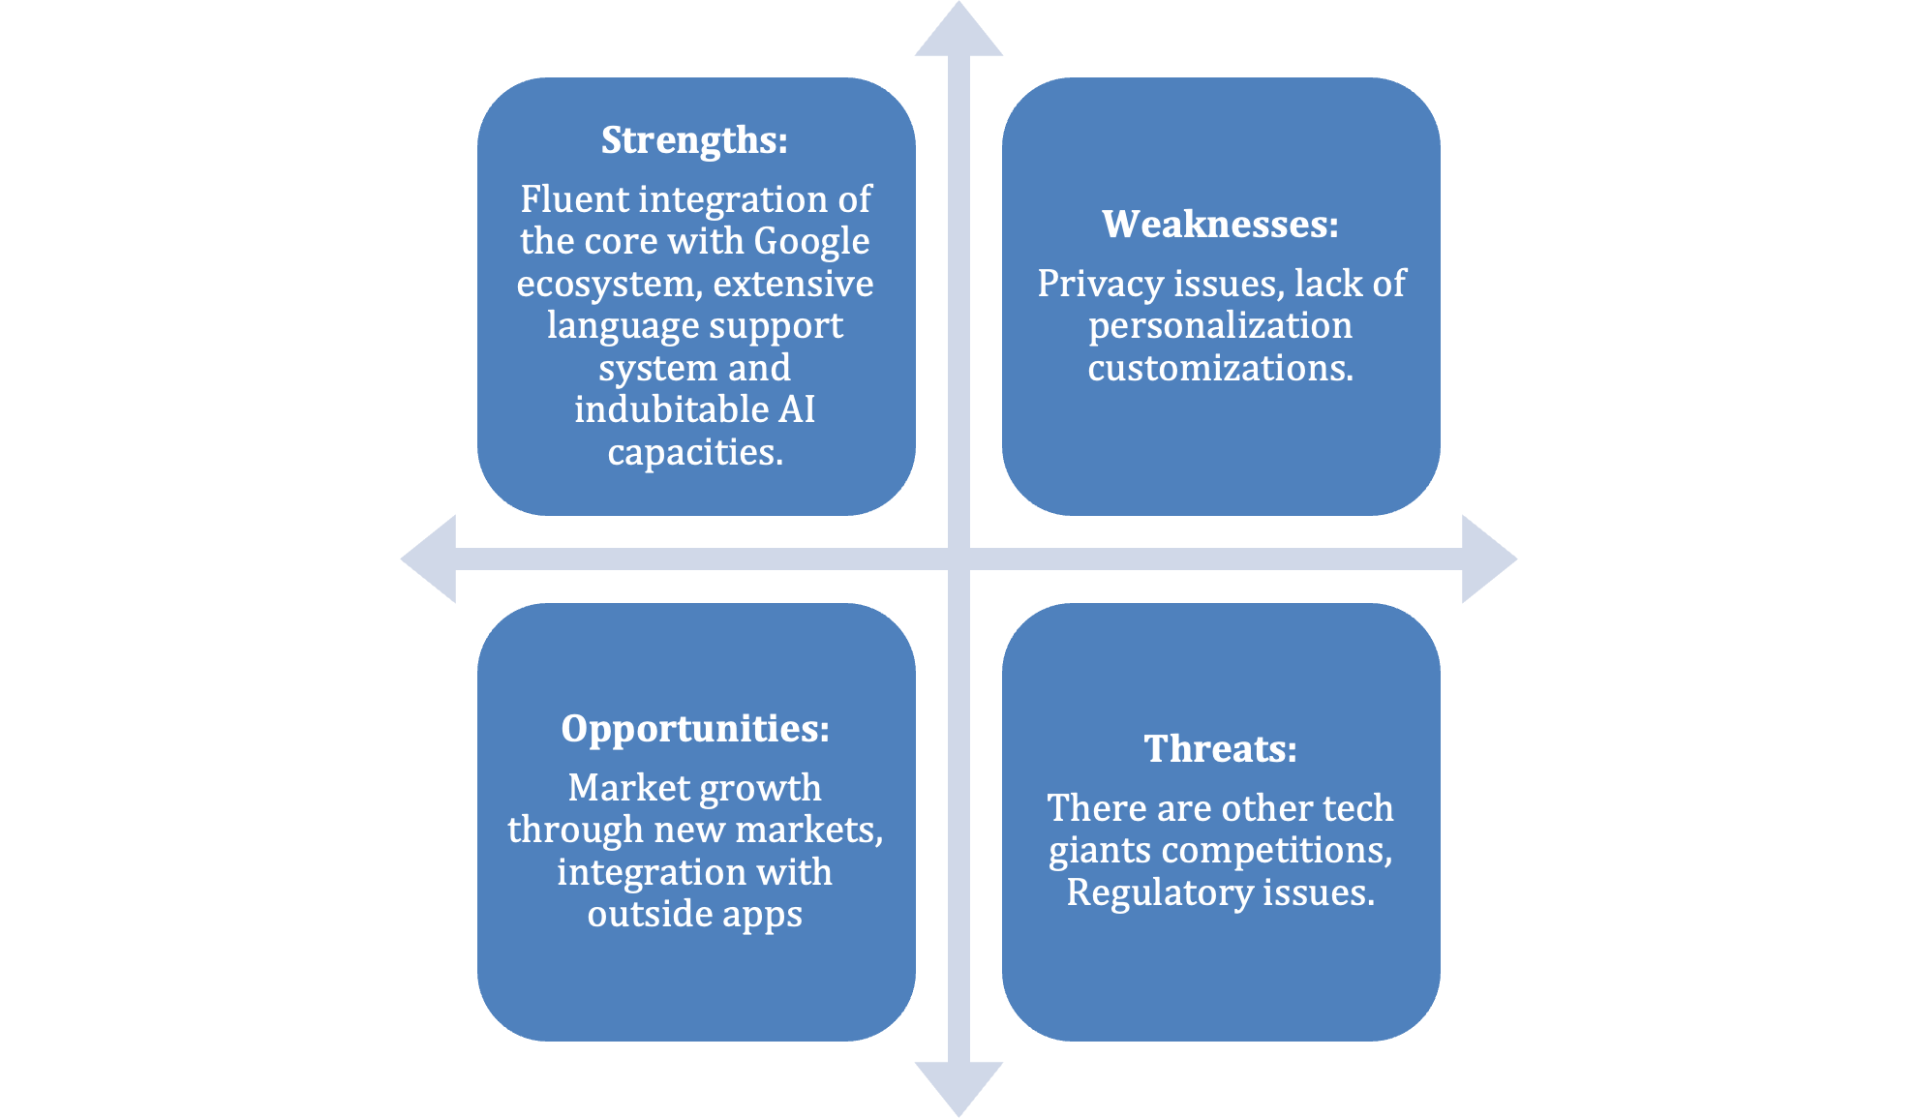
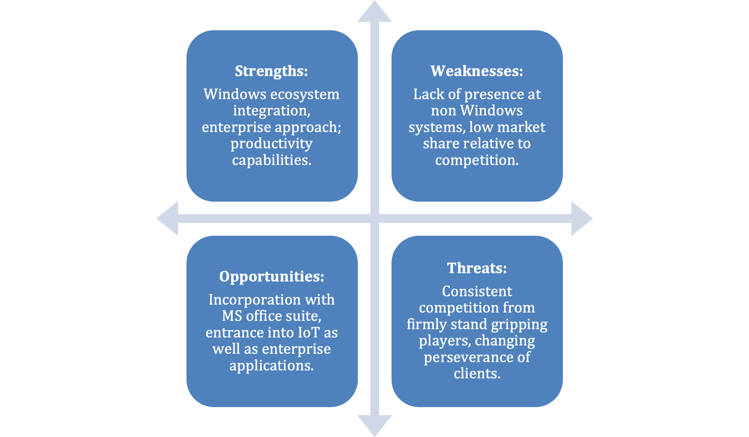
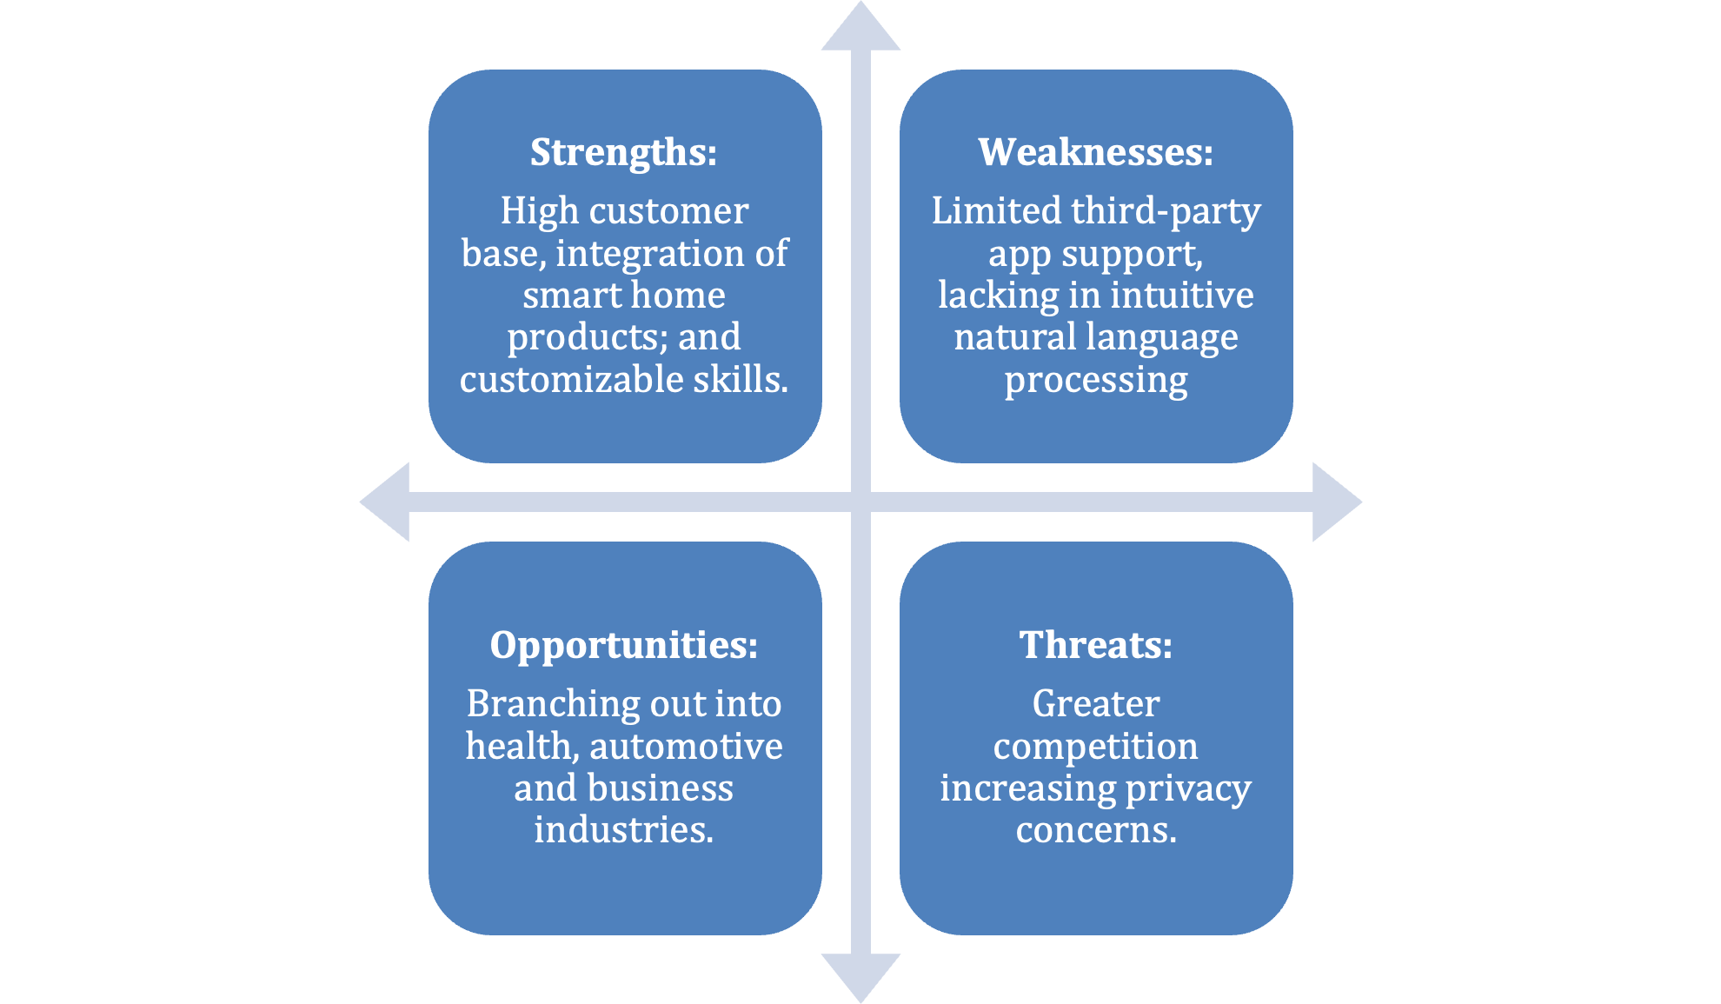
SWOT ANALYSIS OF EXISTING SOLUTIONS
AMAZON ALEXA
GOOGLE ASSISSTANT
MICROSOFT CORTONA

Slide 10
Unique Selling Points
Google Assistant
Amazon Alexa
Privacy measures and customizable settings
Extensive third-party integration
Microsoft Cortana
Apple Siri
Intuitive user experience and accessibility
Expansive ecosystem integration and privacy assurance

Slide 11
03
Feasibility & Viability

Slide 12
Technical Feasibility
Utilize machine learning algorithms for activity recognition, behavior analysis and mood detection
Implement vision recognition for food intake tracking and posture analysis.
Incorporate speech recognition for emotional analysis through voice data.
Implementation Feasibility
Leverage pre-existing libraries and frameworks for activity recognition and behavior analysis.
Utilize cloud computing for scalability and storage.
Address technical challenges in emotion detection algorithm accuracy.

Slide 13
Operational Feasibility
Seamless integration into daily routines for enhanced time management.
Focus on user adoption and engagement through effective advertising, training and customer support.
Prioritize data privacy and security compliance.
Economical Feasibility
Cost Estimation: Estimate development, cloud storage and ongoing maintenance costs.
Return on Investment(ROI) : Explore revenue sources and cost savings opportunities.
Cost-Benefit Analysis : Conduct comprehensive analysis to weigh projected costs against anticipated benefits.

Slide 14
04
Solution Highlights

Slide 15
AuraMind transcends traditional fitness trackers by integrating advanced features like emotional intelligence, personalized scheduling, and health coaching.
Analyzes user behavior patterns, phone usage, and emotional states to provide personalized recommendations and proactive assistance.
Offers a holistic approach to health and productivity management within a user-friendly and secure platform.
SOLUTION OVERVIEW

Slide 16




Key Features and Functionalities
Personalized Scheduling and Task Management
Ai powered health coaching
Intelligence Activity and Routine Learning
Emotional Intelligence and Mood Recognition

Slide 17
Benefits and Impacts
Improved health and well-being
Enhanced productivity and Personalised Experience
Reduced healthcare costs
Valuable data insights

Slide 18
05
Project Plan

Slide 19
Well Planned Project Phases
Design and Architecture
Testing and Quality check
Deployment
Planning
Monitoring
Closure
Initiation
Execution
Requirements Gathering
Development

Slide 20
PROJECT Milestones
Project Kickoff
STAGE 1
System Architecture Design
STAGE 2
Implementation
STAGE 3
Testing
STAGE 4
Product Launch and Maintenance
STAGE 5

Slide 21
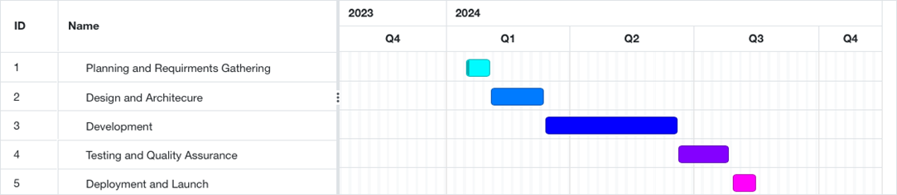
Project Timeline

Slide 22
Project Resources Allocation
Human Resources
Project Manager
Software Developers
UI/UX Designers
Quality Assurance Engineer
Technical Resources
Cloud Computing Services
Development Tools
Testing Tools

Slide 23
06
Risk Management

Slide 24
Types of Risk
Technical
Legal
Ethical & Privacy
Operational
Social
Economic

Slide 25
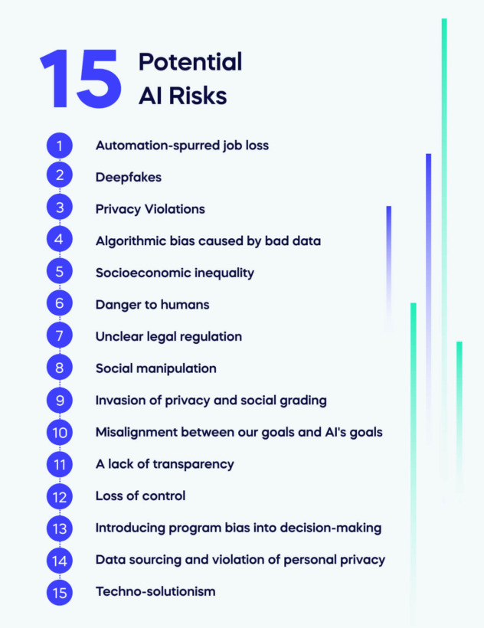
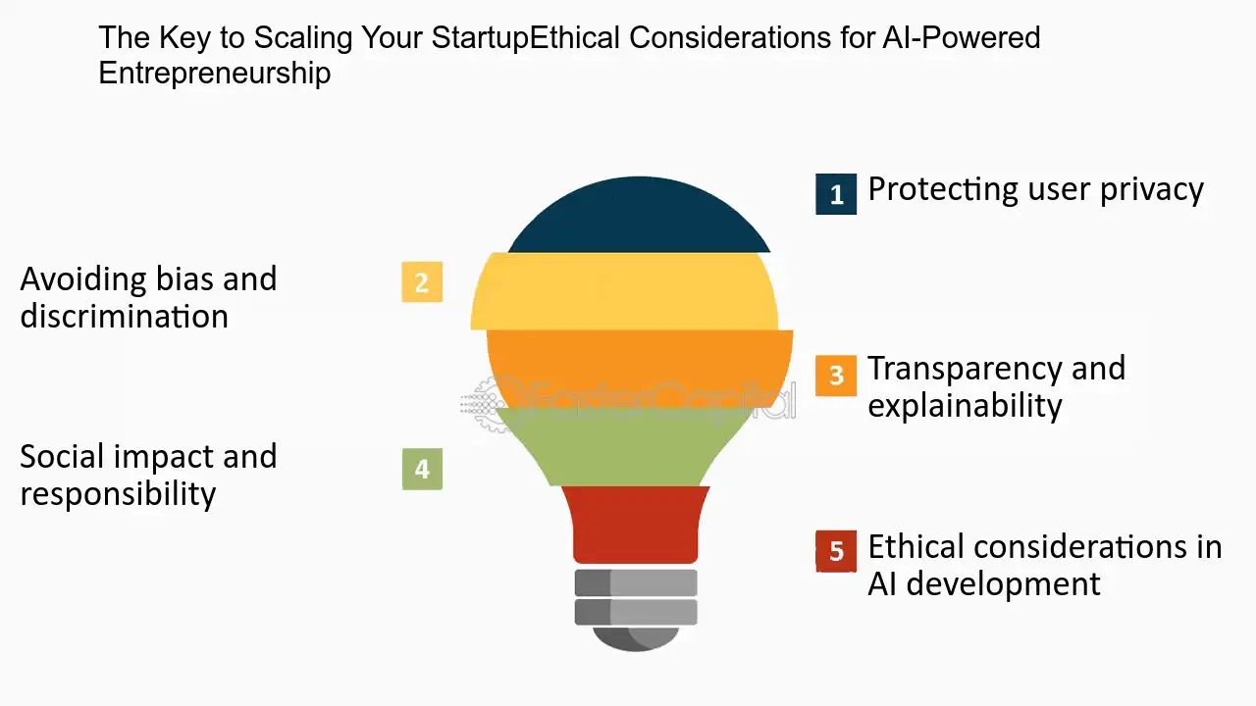

Slide 26
Challenges and Mitigation
Potential Challenges
1. Challenge: Ensuring high-quality, unbiased training data can be difficult due to historical biases.
- Solution: Implement rigorous data quality checks, actively seek diverse datasets, and employ bias reduction techniques.
2. Challenge: Establishing effective human oversight without hindering AI efficiency.
- Solution: Establish explicit policies for AI use, create accountability systems, and foster a culture of responsible AI development.
3. Challenge: User misunderstanding of AI capabilities and limitations.
- Solution: Develop education programs, user-friendly interfaces, and transparent communication about AI.
Risk Mitigation
1. Privacy and Data Security:
- Implement strong end-to-end encryption for data in transit and at rest.
- Comply with data protection (e.g., GDPR).
2. Reliability and Accuracy:
- Continuously update and expand training datasets to improve accuracy.
- Implement a feedback loop for users to correct and enhance AI responses.
3. Malicious Use:
- Collaborate with cybersecurity experts to address emerging threats.
4. Ethical Concerns:
- Provide transparency in decision-making processes to build user trust.
- Regularly review and update ethical guidelines based on societal changes.

Slide 27
07
Budget

Slide 28
Cost Categories
Human Resources
$412,109 CAD
Testing
$11,692 CAD
Ongoing Maintenance
$15,000 CAD
Technological Resources
$50,000 + AI models cost

Slide 29
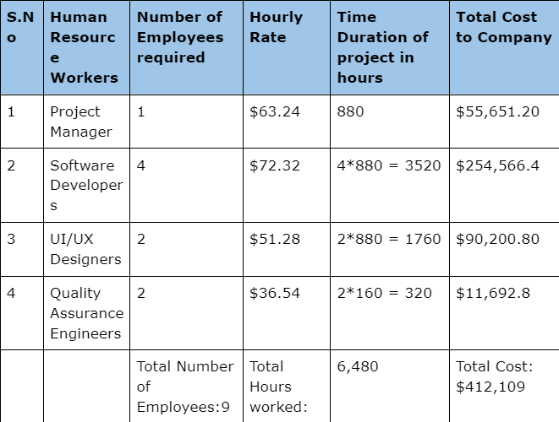
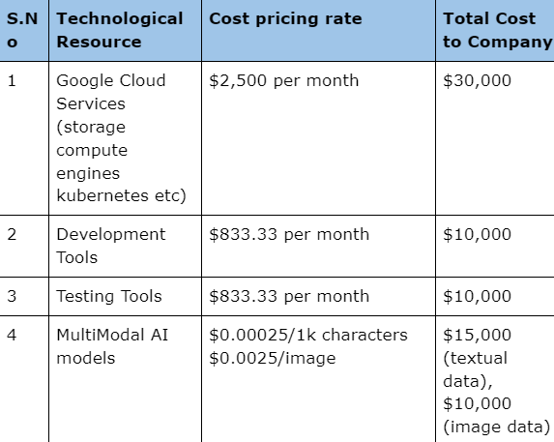
Human and Technological Resource Breakdown

Slide 30
ADDITIONAL RESOURCE COSTING
Contingency Budget
$48,000 CAD(10% of total estimated budget)
It ensures flexibility to address unforeseen risks ensuring project completion with budget constraints

Slide 31
08
Conclusion

Slide 32
In conclusion, AuraMind represents a groundbreaking advancement in the realm of personal health and productivity management. Through the integration of cutting-edge AI technologies, AuraMind offers users a comprehensive solution tailored to their individual needs and preferences.
By leveraging machine learning algorithms, emotional intelligence analysis, and personalized scheduling features, AuraMind empowers users to take control of their lives and achieve their full potential.
Furthermore, AuraMind's potential impact extends beyond individual users. By reducing healthcare costs, increasing employee productivity, and providing valuable data insights, AuraMind contributes to broader societal and economic benefits.
As we move forward, we are excited about the possibilities AuraMind presents for revolutionizing how individuals manage their health and productivity. With continued innovation and dedication, AuraMind is poised to make a significant and lasting impact on individuals, organizations, and society as a whole.

Slide 33
THANK YOU!
For joining us on this journey towards a healthier , more productive future with AuraMind

Slide 34
REFERENCES
https://www.techtarget.com/searchcustomerexperience/definition/virtual- assistant-AI-assistant
https://reply.io/virtual-ai-assistant/
https://scoop.market.us/virtual-assistant-statistics/
https://builtin.com/artificial-intelligence/ai-assistant
https://www.semrush.com/blog/ai-assistant/
https://blog.hubspot.com/marketing/ai-assistant
https://voicebot.ai/2019/06/21/voice-assistant-demographic-data-young-c onsumers-more-likely-to-own-smart-speakers-while-over-60-bias-toward-al exa-and-siri/
https://zapier.com/blog/best-ai-scheduling/
https://clickup.com/blog/ai-tools-for-virtual-assistants/

